Slide 1

Control
Team: Big Gains B-)
Debby Lin
Ebi Mir-Mohammadsadeghi
Harsh Rajoria

Slide 2

Control System Overview

Slide 3
Control System Overview

Slide 4
Control System Linear Models

Slide 5
Control System Optimization

Slide 6
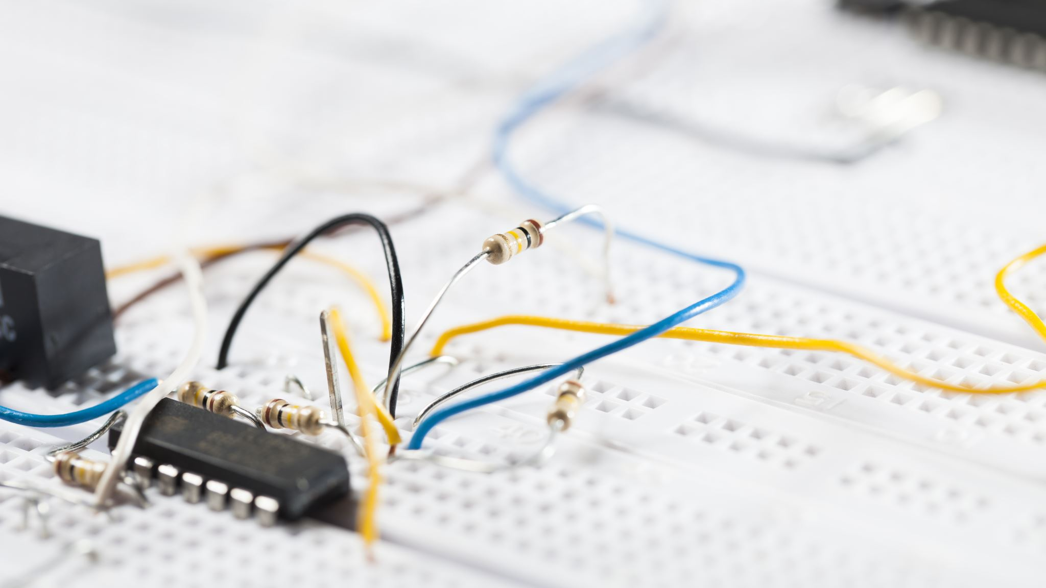
Controller

Slide 7
Matlab Function

Slide 8
Derivative Filter

Slide 9
Arduino

Slide 10
Filter Pole

Slide 11
Co-Simulation

Slide 12

Robotics

Slide 13
Direct Kinematics

Slide 14
Derivative Filter

Slide 15
Inverse Kinematics

Slide 16
Path Planning

